Slide 1
CNCF Ambassadors: Building the Cloud Native Community
Alison Dowdney, Weaveworks
Jessica Andersson, Annotell
Kasper Nissen, Lunar
Saiyam Pathak, Walmart Labs
Moderated by:
Ihor Dvoretskyi, CNCF

Slide 2
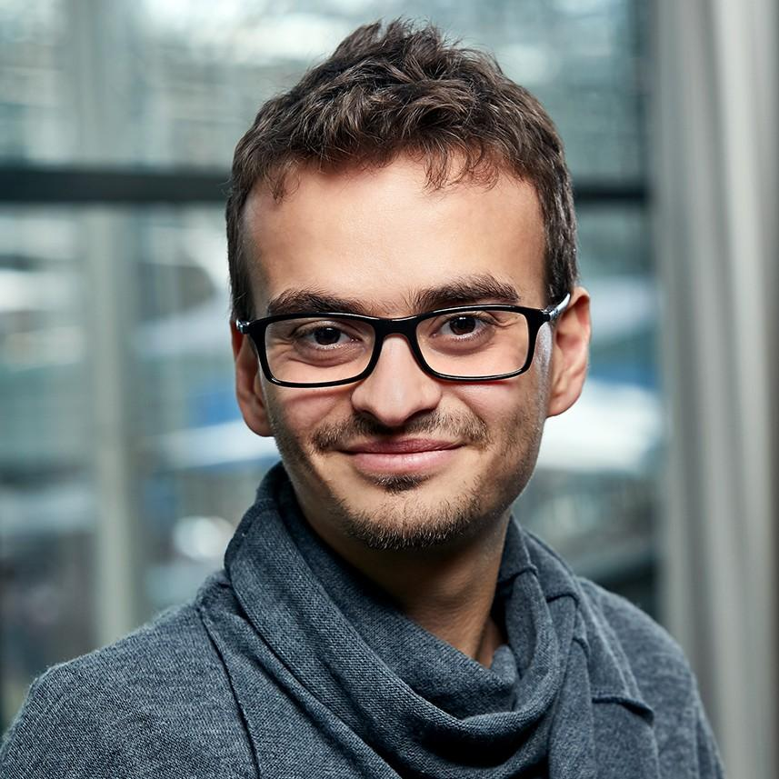
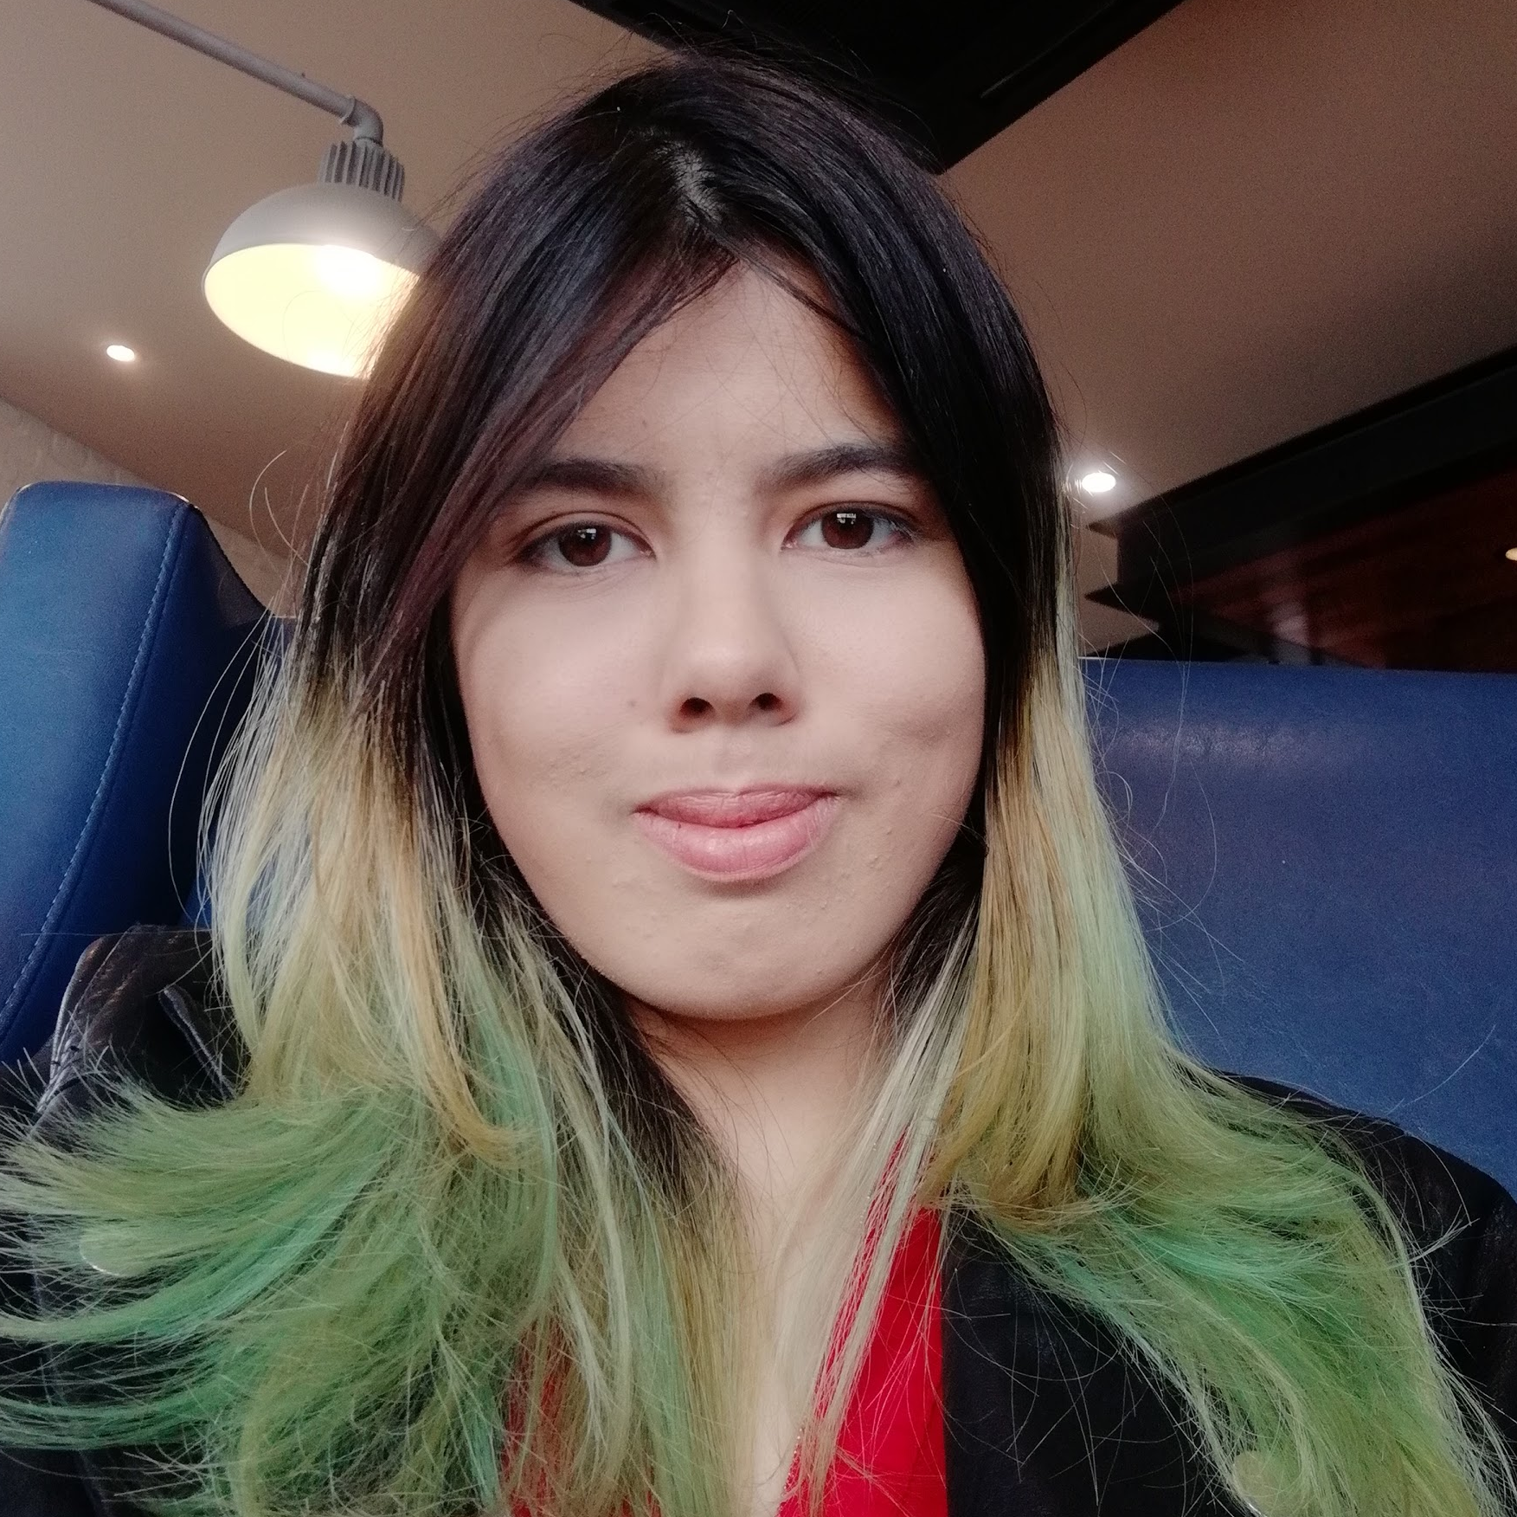
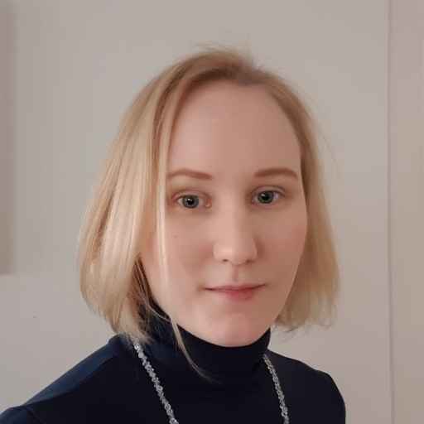
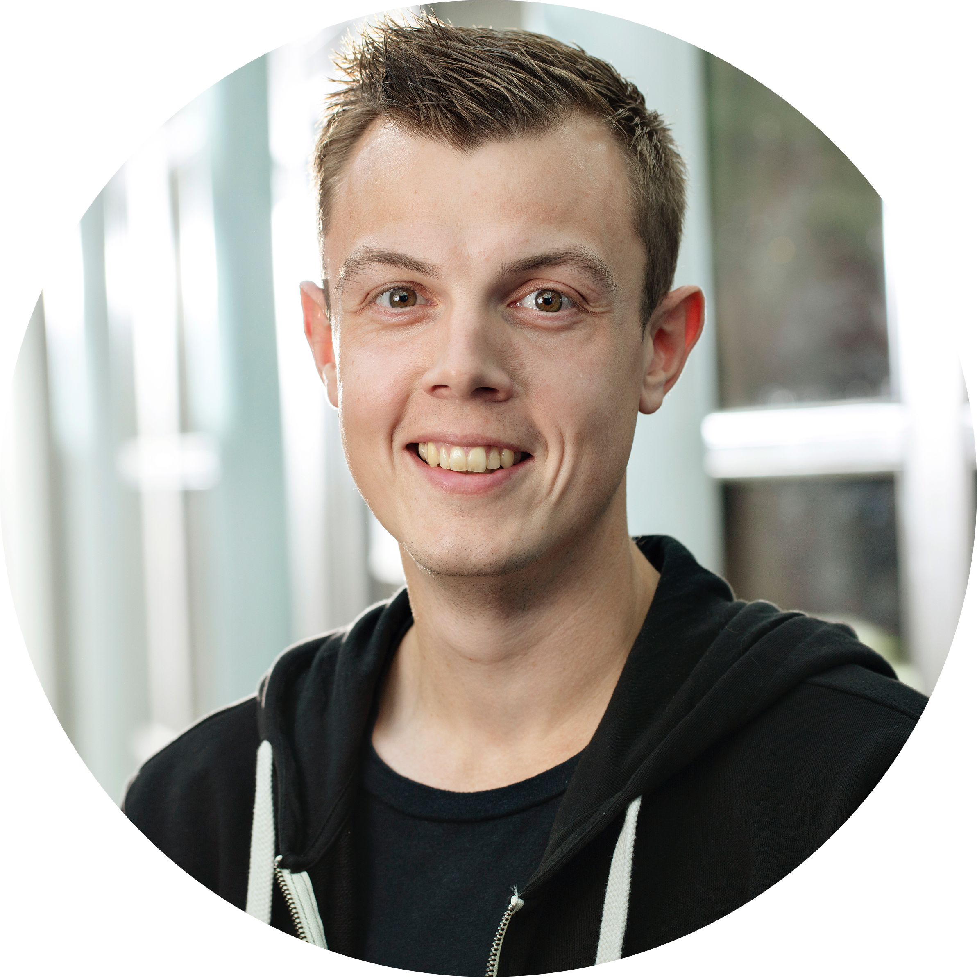
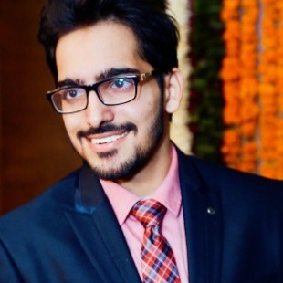
Speakers
Jessica Andersson
@solidtubez
Saiyam Pathak
@saiyampathak
Ihor Dvoretskyi
@idvoretskyi
Alison Dowdney @alisondowdney
Kasper Nissen @phennex

